Slide 1

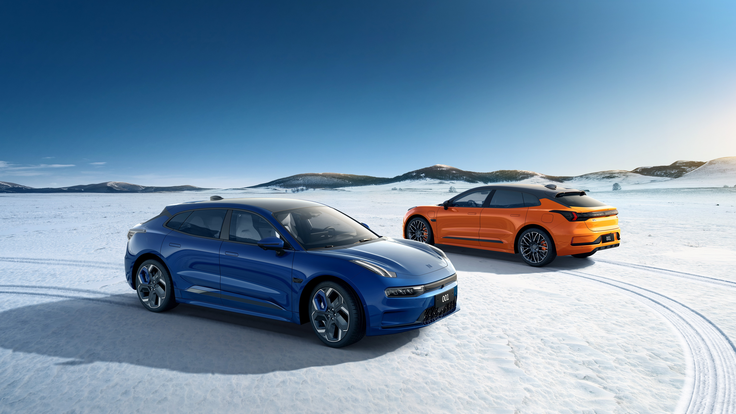
Z E E K R 0 0 1
Premium Shooting Brake

Slide 2
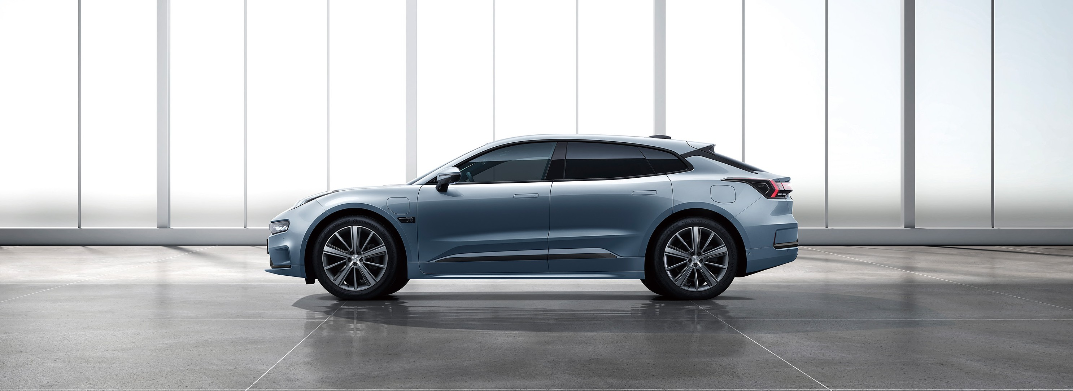
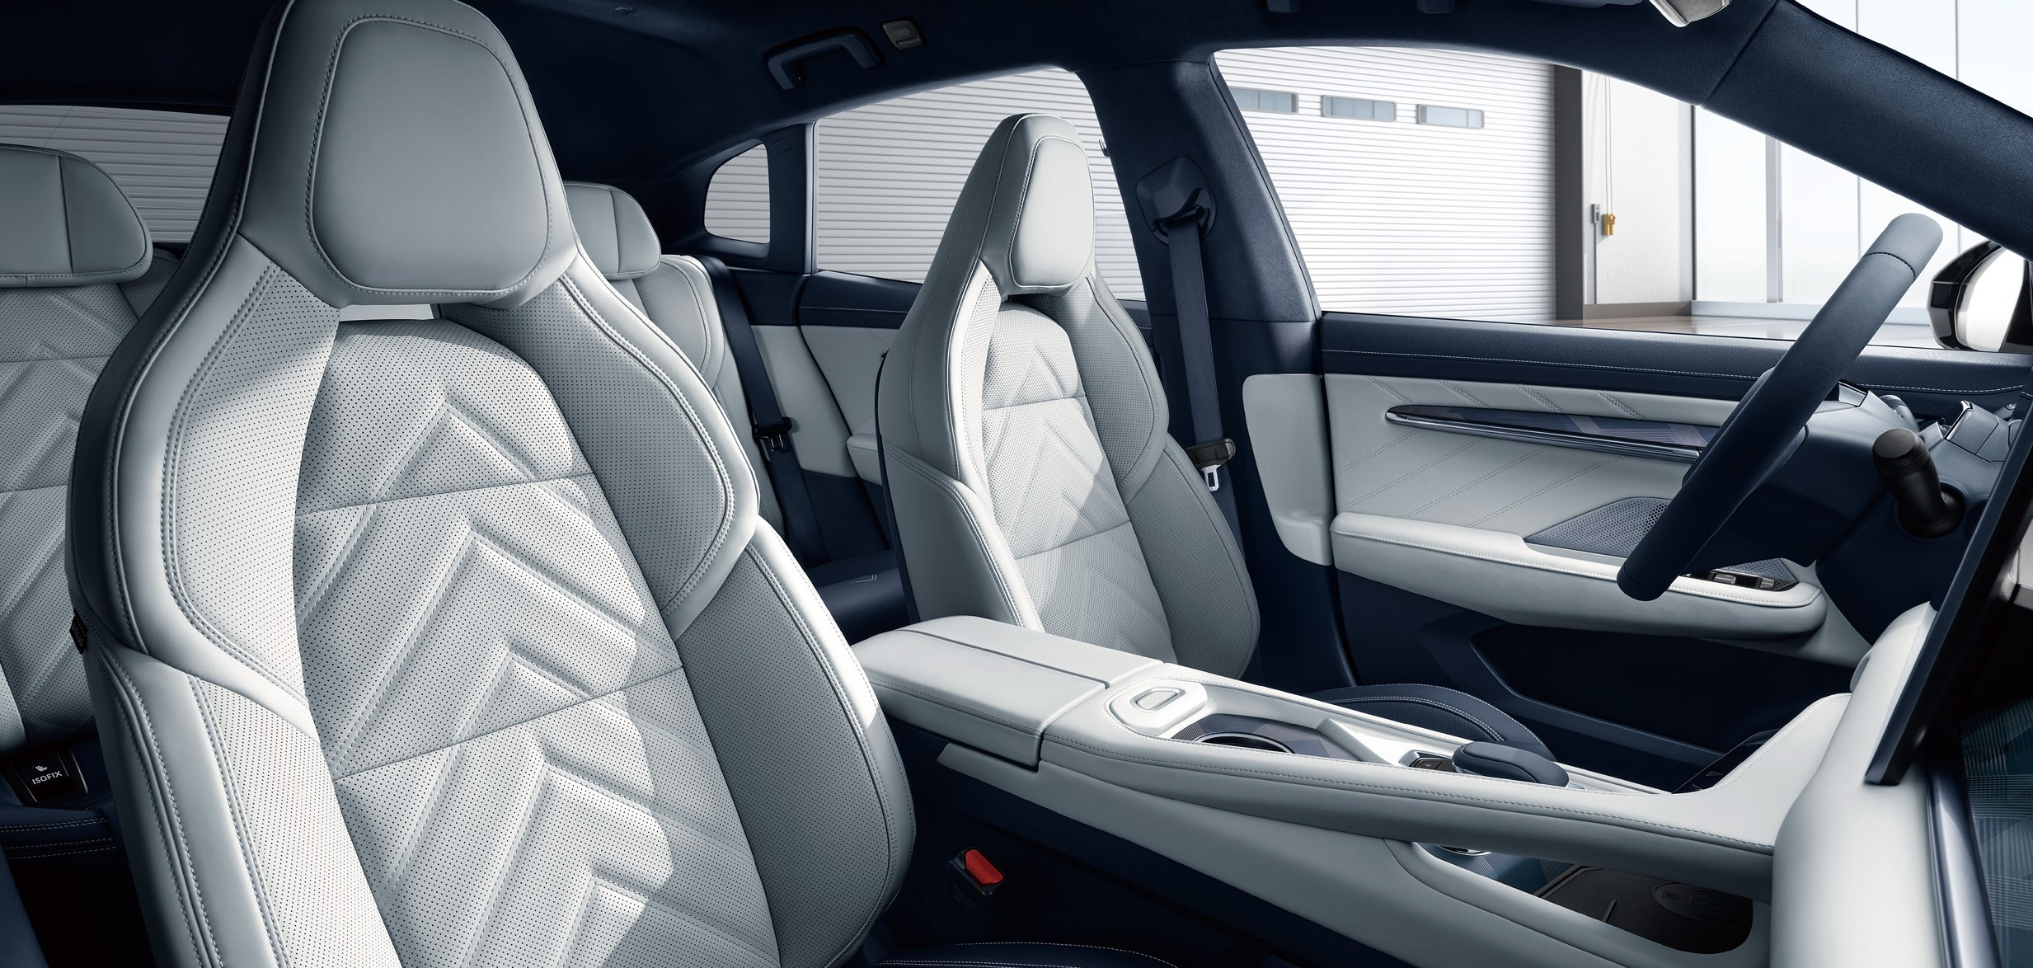
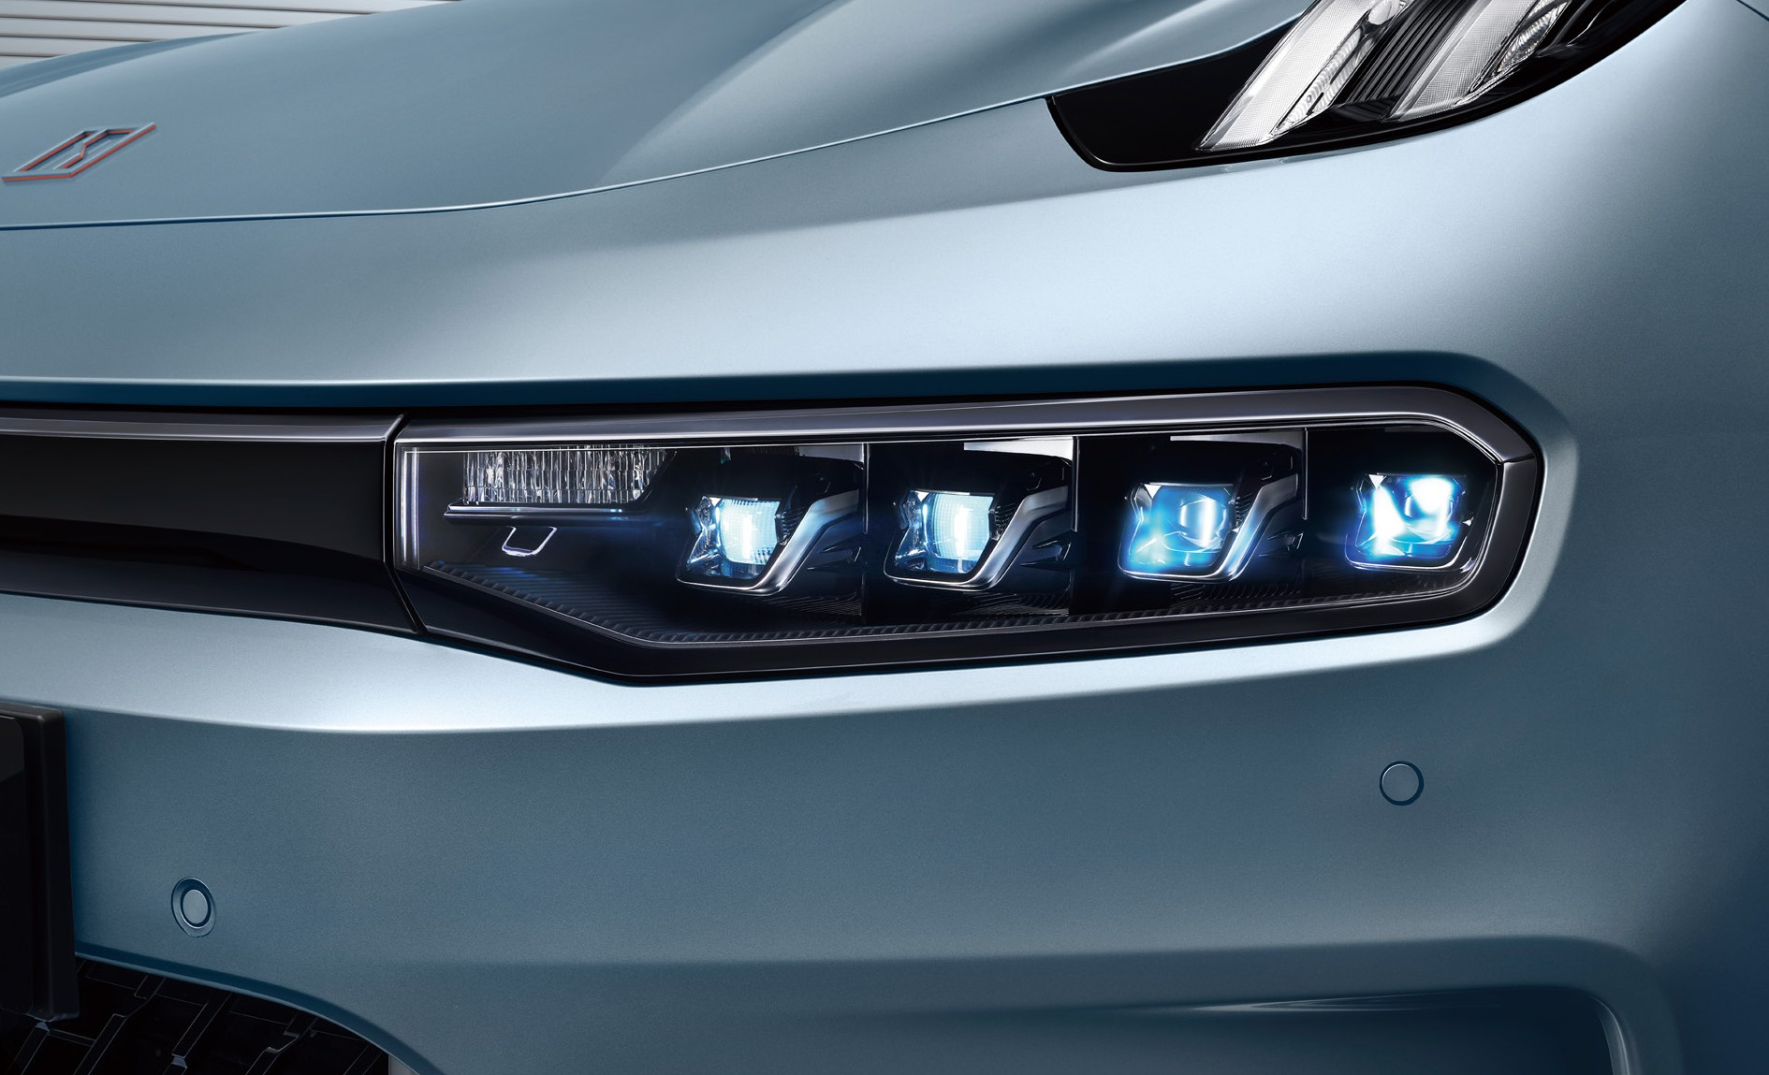
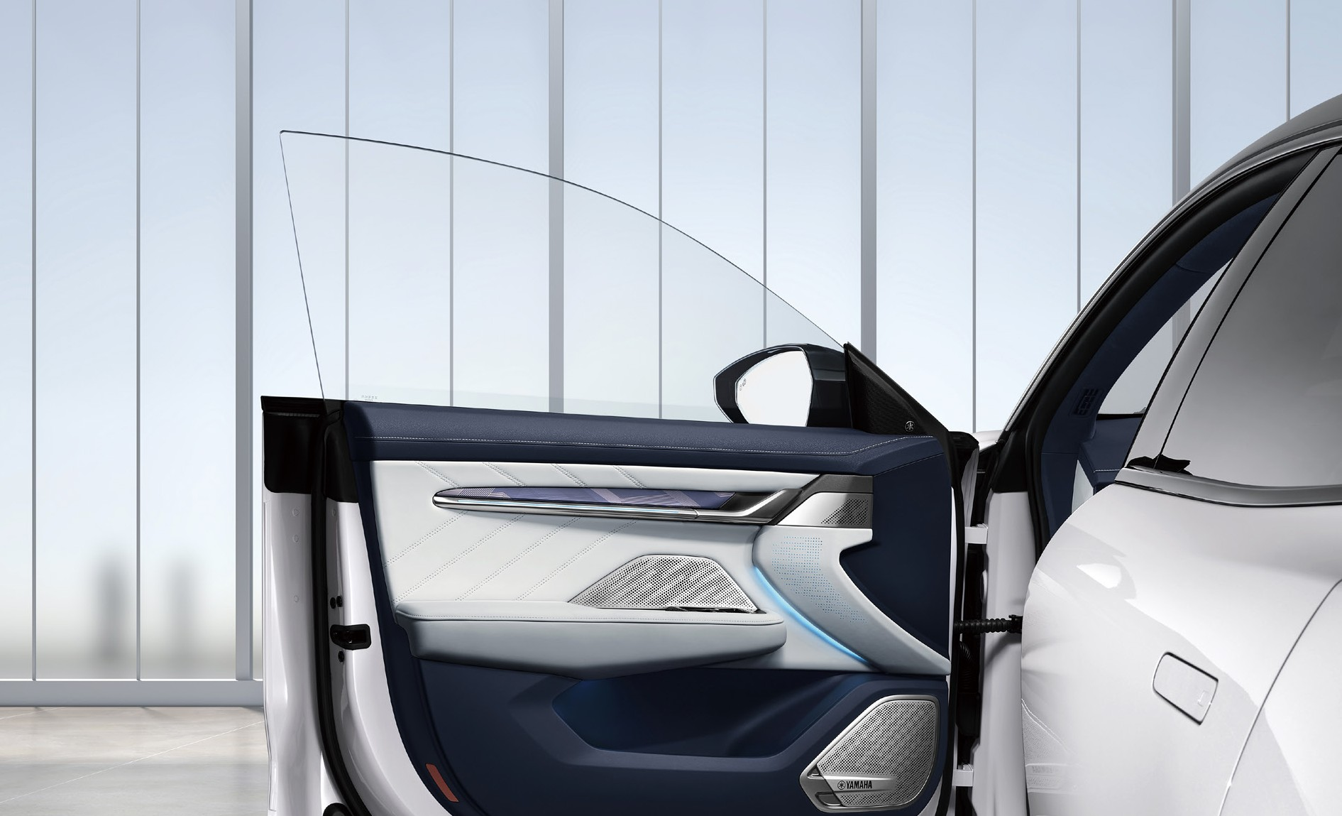
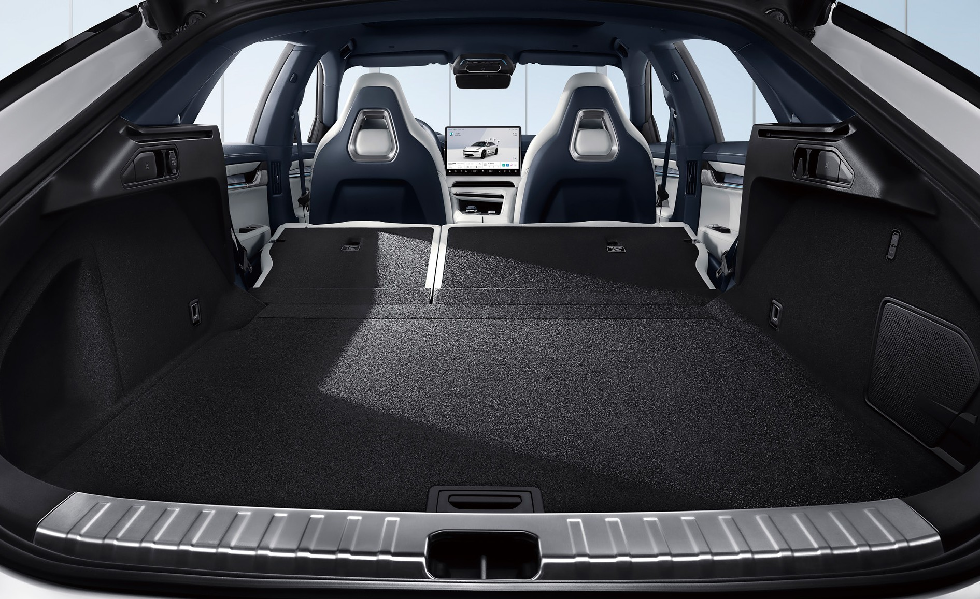
Full Scenario Charming
Exterior Elegance, Interior Luxury
Unique shooting-brake design enables ZEEKR 001 to show its characteristic charm, combining elegance and practicability. Together with the user to gain a high rate of attention, its beauty is superb in all the photos.
Suede × Top leather sports stitches seats
All Seats Electric Adjustment
Front-Row Seats Ventilation/Massage/Memory
0.23 cd Super Low Coefficient of Drag
2,999 mm Super Long Wheel Base
4 Induction Frameless Automatic Doors
4 Silent E-Latch Doors
Intelligent Matrix LED Projection Headlamp
2144L Magic Traveler Back Trunk

Slide 3
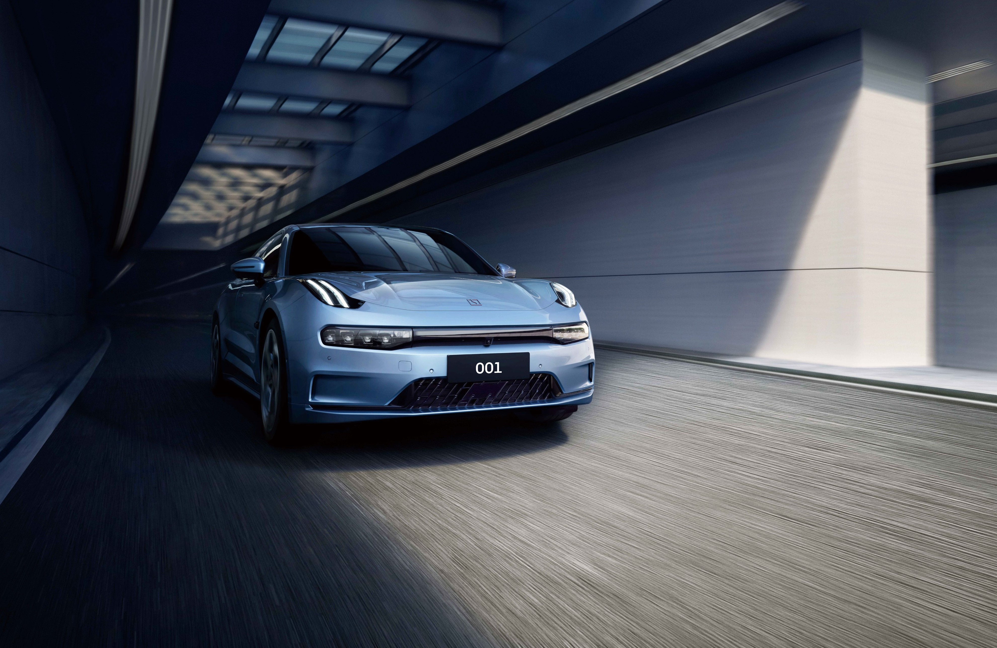
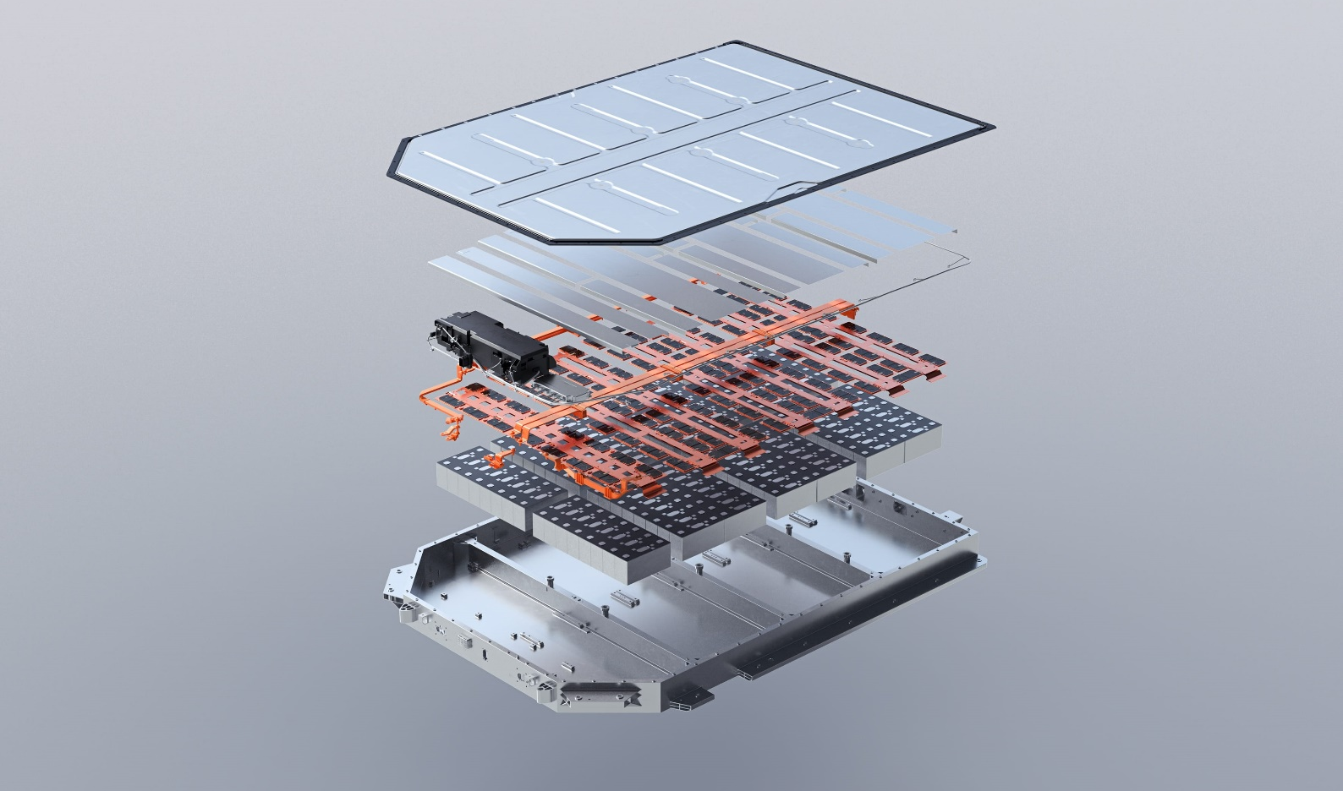
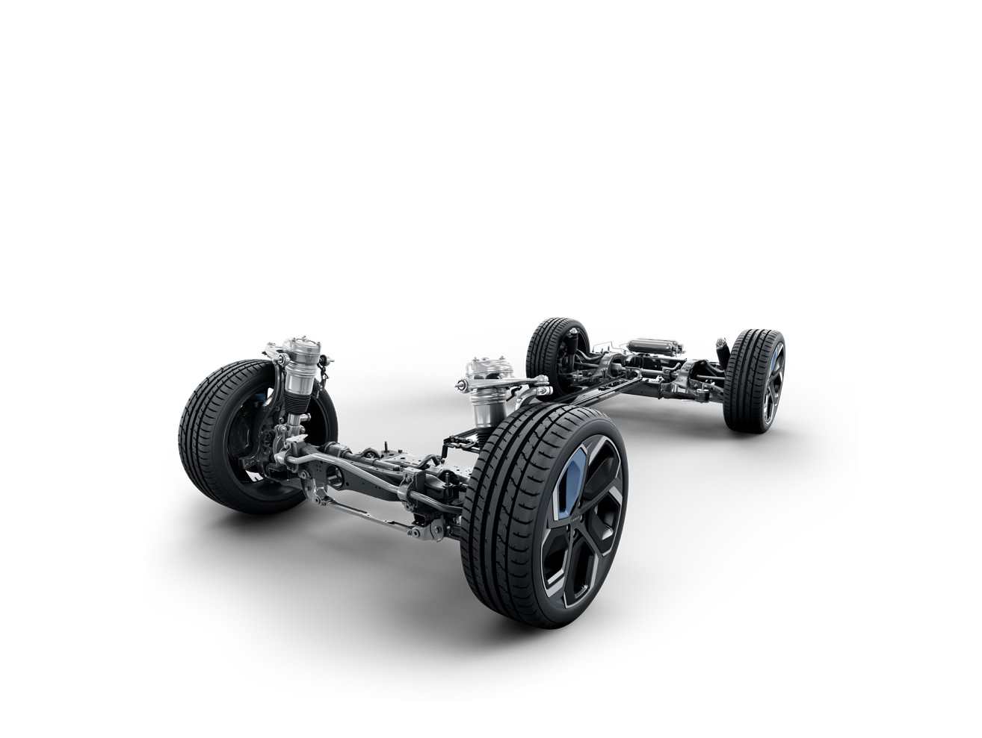
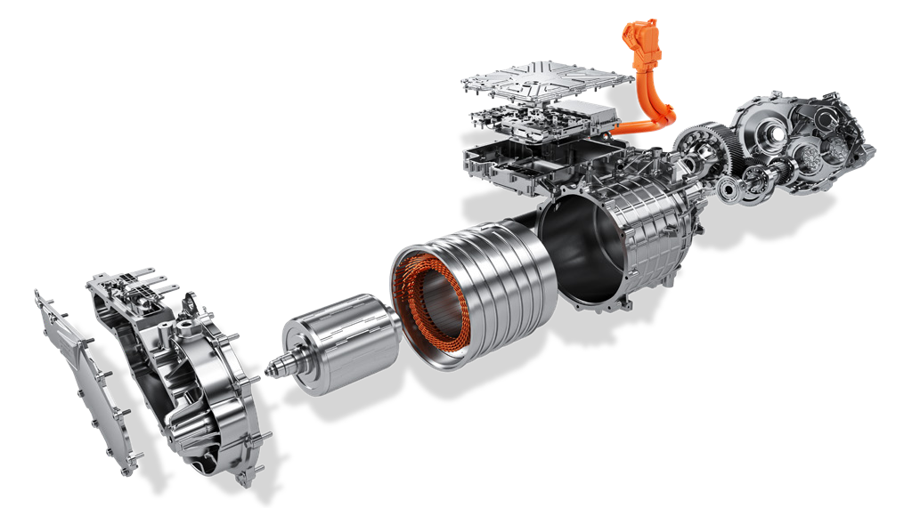
Full Electric Performance
Powerful Hardware, Mighty Performance
Powerful hardware and latest software enables ZEEKR 001 with electric character, and high-end team’s conditioning capacity enables it to release mighty electric performance in front of various road conditions in a twinkling.
100 kWh
620 km
Ni55+ CTP battery
RWD Range of WLTC
High-Performance PMSM System
E-Motor Efficiency 97.86% ，Rotate Speed 16500 rpm
3.8 s 0-100 km/h acceleration
7 Driving Modes
Flash Switch Intelligent AWD
dTCS Intelligent Anti-Skid System
High-Performance Air Suspension
International Sports Car Team Conditioning

Slide 4
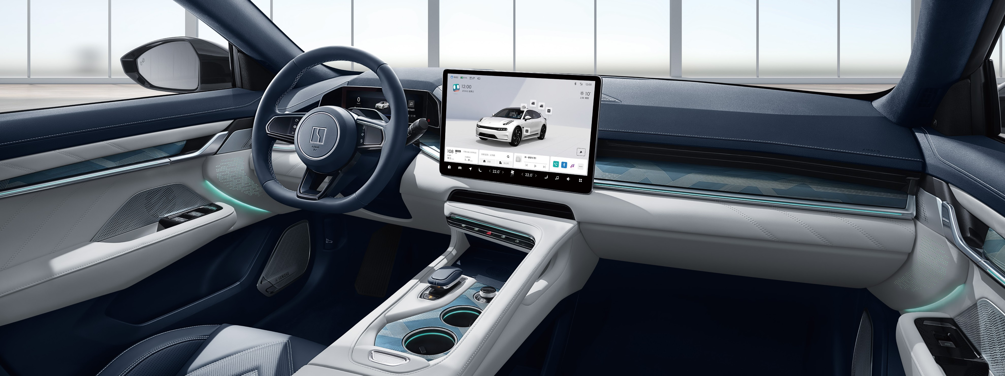
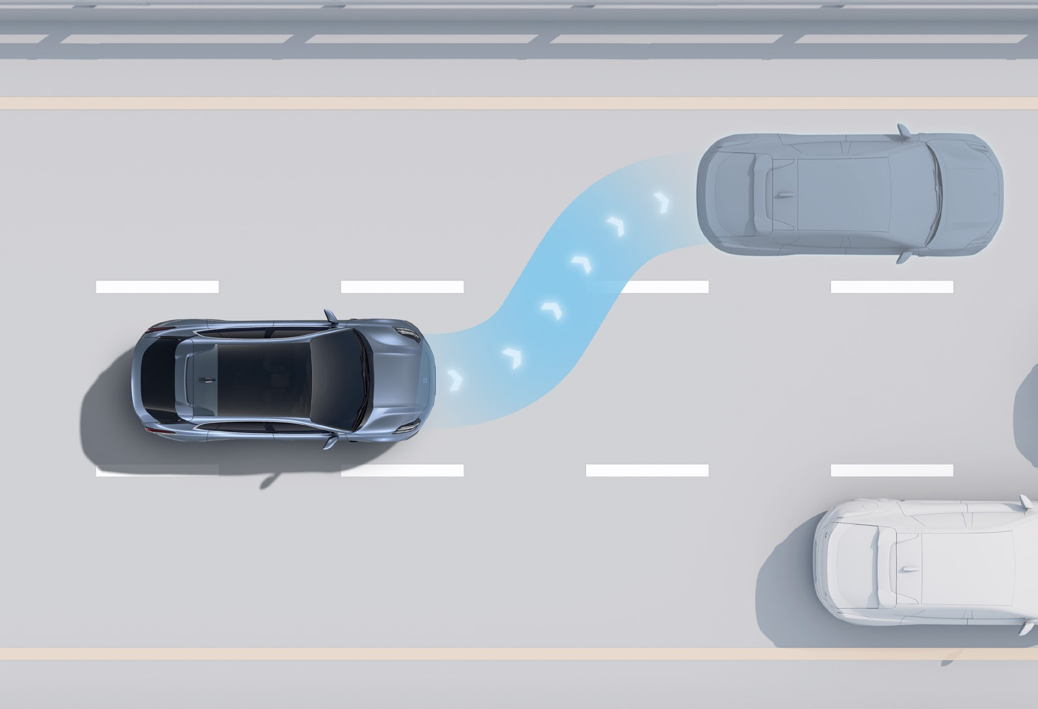
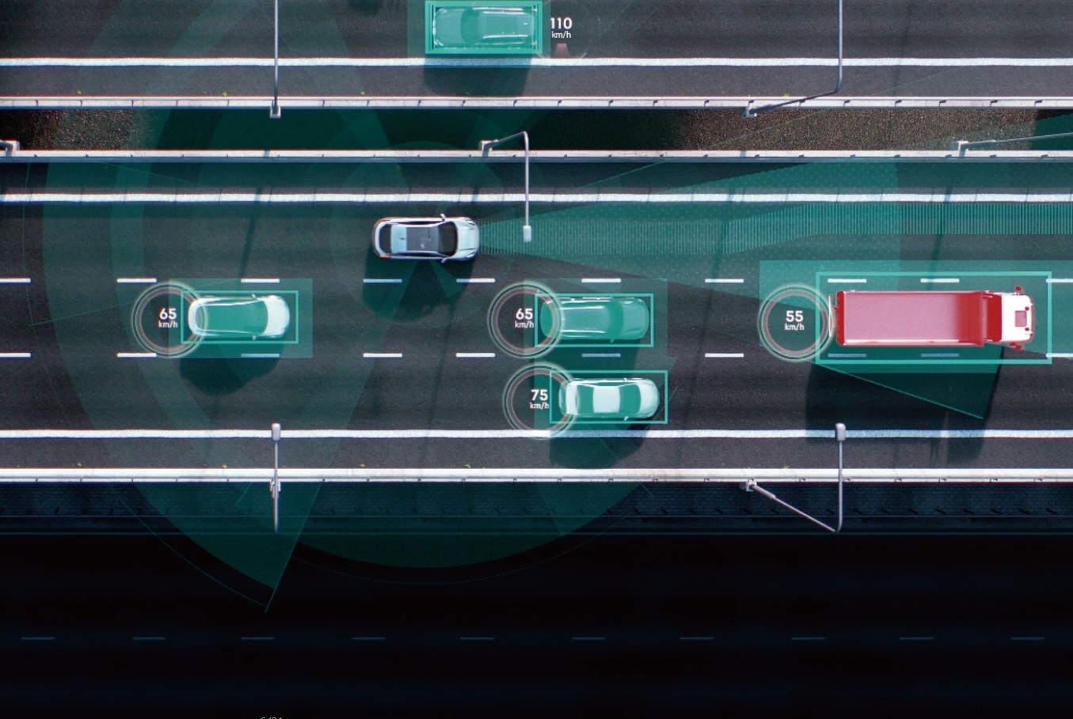
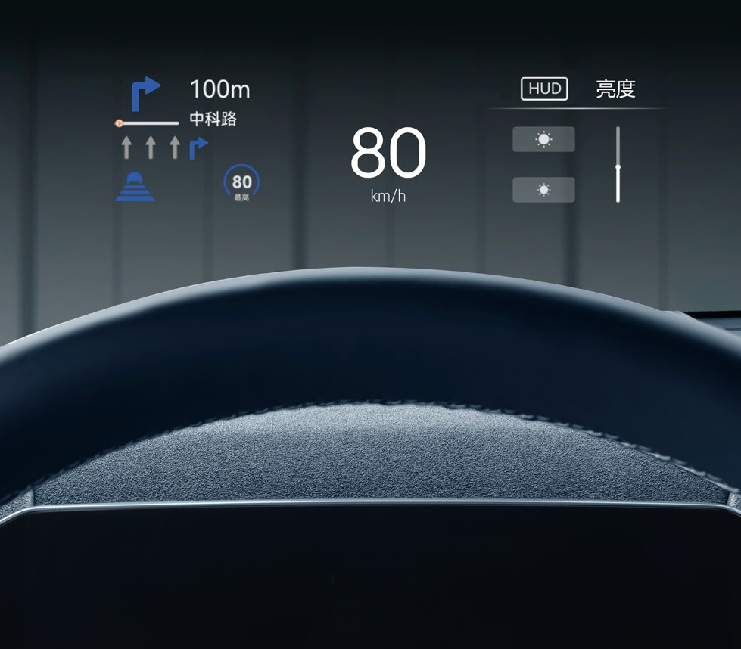
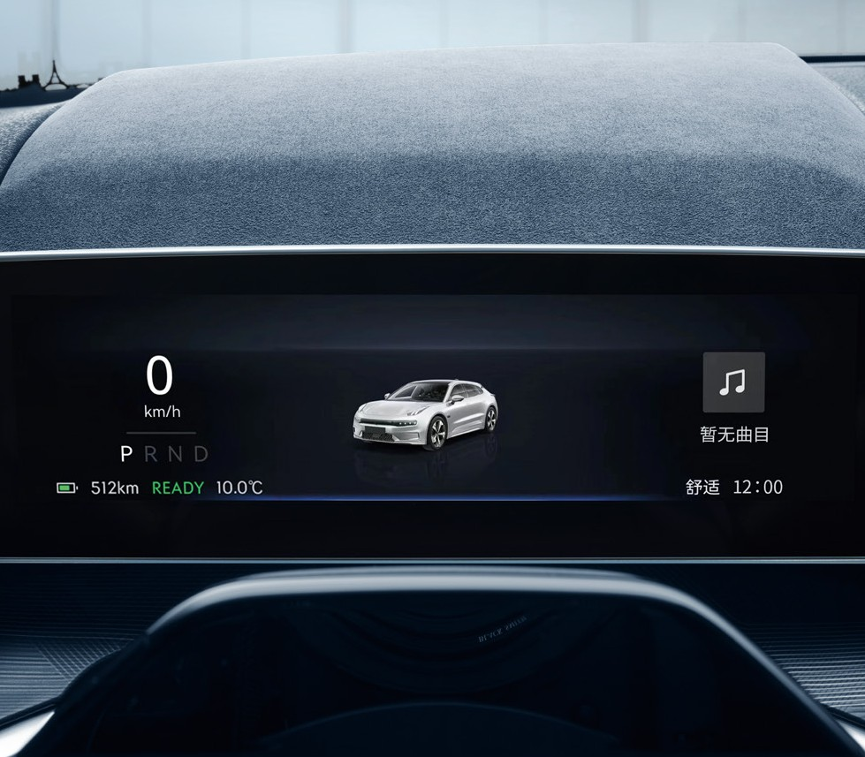
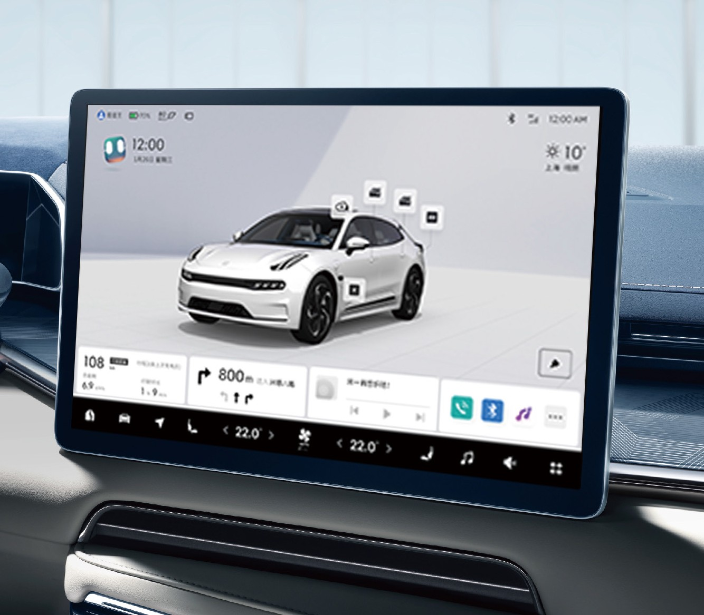
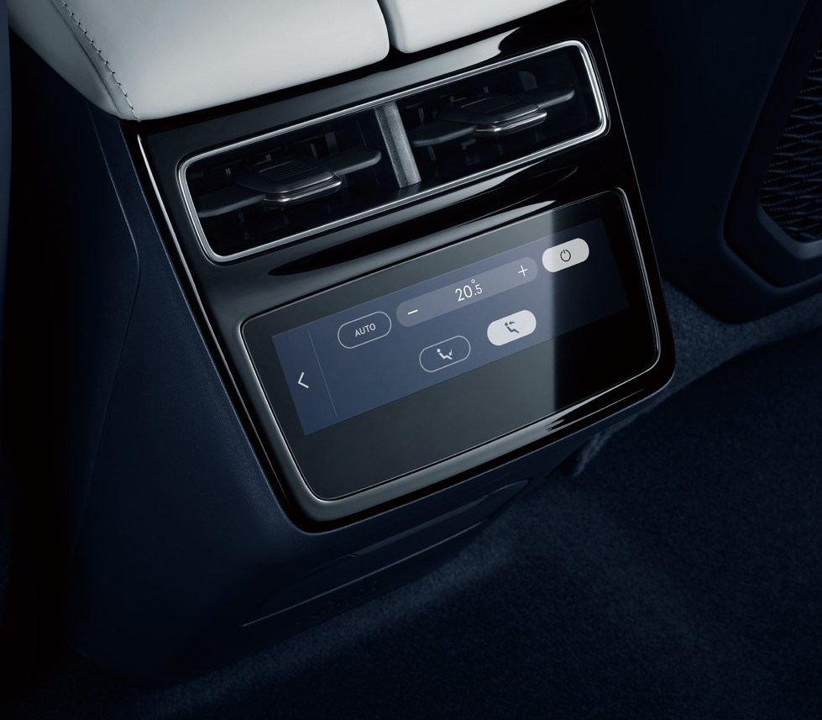
Full Intelligent Experience
Strong Hardware Pre-Installation, Latest Software Enabling
With 8155 Intelligent Cockpit Computing Platform’s mighty prescient interaction system, it revolutionarily changed interaction experience, enabling you to experience all-new high-level intelligent driving experience.
L2+ ADAS 10+ Leading Features
LCC/DOW/LKA/AEB/HWA
8155 Intelligent Cockpit Computing Platform ZEEKR Prescient Interaction System
7nm Mobileye EyeQ5H Double Chips
Falcon Eye Vidar Visual-Fusion Perception System
Advanced Visual-Fusion Computing Capacity
Intelligent 4-Screen Interaction System

Slide 5
ZEEKR 001 SPECS SHEET
Trim Level | Standard RWD | Premium AWD | Flagship AWD
Specifications
Length (mm) | 4,955 | 4,955 | 4,955
Width (mm) | 1,999 | 1,999 | 1,999
Hight (mm) | 1,560 | 1,560 | 1,548
Wheel Base (mm) | 2,999 | 2,999 | 2,999
Ground Clearance/Ride Hight (mm) | 174 | 174 | 162
Performance & Handling
Battery & Electric Motor & Electric Control
Battery Capacity (kWh) @1C | 100 | 100 | 100
WLTC Range (km) | 620 | 580 | 580
0-100km/h Acceleration Time (s) | 7.2 | 3.8 | 3.8
Max. power (kW/HP) | 200 / 272 | 400 / 544 | 400 / 544
Max. torque (Nm) | 343 | 686 | 686
Charging time 10-80% (200kW DC) (mins) | 30 | 30 | 30
Charging time 0-100% (22kW AC) (h) | 5.5 | 5.5 | 5.5
Steering Wheel
Steering Wheel Telescopic Adjustment: 4-Way, Manual | ● | - | -
Steering Wheel Telescopic Adjustment: 4-Way, Powered | - | ● | ●
Steering Wheel Implemented Function - Heating | ● | ● | ●
Steering Wheel with Memory | - | ● | ●
Chassis/Undercarriage
Front Suspension - Wishbone/Short Long Arm (SLA) | ● | ● | ●
Rear Suspension - Integration Link | ● | ● | ●
Air Suspension | - | - | ●
Driving Mode Selection (Comfort, Economy, Sport, Personalization) | ● | ● | ●
Advanced Driving Mode Selection (Snow, Sand Road, Off-Road) | - | ● | ●
Design & Functions
Lighting & Aesthetics
Ambience Light - White Light: Foot Location Only | ● | ● | ●
Ambience Light: 3-Color Adjustable | ● | ● | -
Ambience Light: 12-Color Adjustable | - | - | ●
Ambience Light: Brightness and Color Adjustable | - | - | ●
Doors & Glass & Mirrors
Frameless Window Front & Rear Doors | ● | ● | ●
E-Latch Front & Rear Doors | - | - | ●
Electric Liftgate with Height Adjustment & Memory Function | ● | ● | ●
Panoramic Sunroof: Heat-Protecting | ● | ● | ●
Electric Adjustable Exterior Mirrors (Heating, Folding, Memory, Auto. Dipping when Reversing) | ● | ● | ●
Exterior Mirrors Auto. Dimming | - | - | ●
Inside Rear View Mirror: Frameless, Auto. Dimming | ● | ● | ●
Seat & Craft & Functions
Seat Material & Craft: Environment Friendly Material; Surface Perforation; Sporty Stitch | ● | ● | ●
Driver Seat 12-Way Powered Adjustment | ● | ● | ●
Front Row Seat Ventilation/Message | O1 | O1 | ●
Front Passenger Seat 8-Way Powered Adjustment | ● | ● | ●
2nd Row Seat Adjustment: 2-Way Powered; | ● | ● | ●
Traveler's Magic Backpack
Max. Expandable Storage Volume in the Trunk (L) | 2,144 | 2,144 | 2,144
Luggage Capacity, ISO (l) | 539 | 539 | 539
12V Power Output in Trunk | ● | ● | ●
Trim Level | Standard RWD | Premium AWD | Flagship AWD
Safe & Smart Driving* (ADAS function list, see the next sheet)
Active and Passive Integrated Safety Protection System
360° Camera | ● | ● | ●
Digital Video Record (DVR) | ● | ● | ●
7 Air Bags Front Passenger Airbag Physical Switch | ● | ● | ●
Intelligent Cockpit & Mobility Ecology
Intelligent Cockpit
8.8'' High-Definition Instrument Cluster | ● | ● | ●
15.4'' Central Screen Display | ● | ● | ●
14.7'' Virtual Image Aircraft Cabin Head-Up Display (HUD) | ● | ● | ●
5.7'' Rear Console Screen | - | - | ●
8-Speaker High Performance Audio | ● | ● | -
YAMAHA Suround Stereo Premium Audio (11 Speakers and 1 Subwoofer) | O2 | O2 | ●
Mobile Phone Wireless Charging | ● | ● | ●
2 Front Row USB Ports, incl. 1 USB 2.0 Data Transfer; 2 Rear Row USB Ports: 1 Type A, 1 Type C | ● | ● | ●
Clean Climate-Controlled Cockpit
HVAC- 2 Zone Climate Control System | ● | ● | -
HVAC- 3 Zone Climate Control System | - | - | ●
Air Quality System with N95/PM2.5 Filter | ● | ● | ●
Smart Ecosystem
8155 Intelligent Cockpit Computing Platform | ● | ● | ●
Connected Service System: Carplay & Android Auto (Android Auto: OTA 2024) | ● | ● | ●
NFC Tag, UWB Key fob, Mechanical Key | ● | ● | ●
Exterior & Interior Choices
Exterior
Car Paint
Crystal White | O | O | O
Electric Blue | O | O | O
Tech Grey | O | O | O
Phantom Black | O | O | O
Speed Orange | - | - | O
Sporty Decoration
Aluminum | ● | ● | -
Contrasted Dark | O | O | ●
Wheel Hub
Arc Phantom Wheel: 21'' Alloy OD 760 mm w. tire 255/45R21 (Inter) | ● | - | -
Energy Blade Wheel: 22'' Alloy OD 770 mm w. tire 265/40R22 | - | ● | -
Multi Spoke Sport Forged Wheel: 22'' Forged rim OD 771 mm w. tire 265/40R22 | - | O | ●
Interior
Interior Colors & Materials
Charcoal Black & Stone Grey | ● | ● | ●
Midnight Blue & Polar White | O | O | O
O1 & O2 optional packages may differ depending on available stock

Slide 6
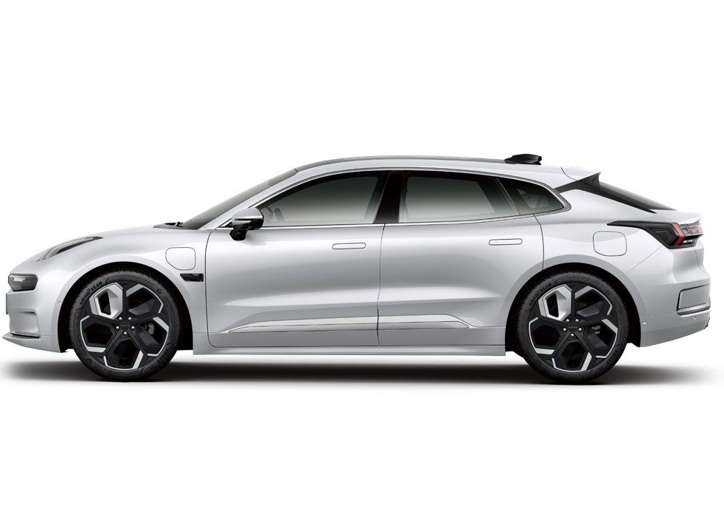
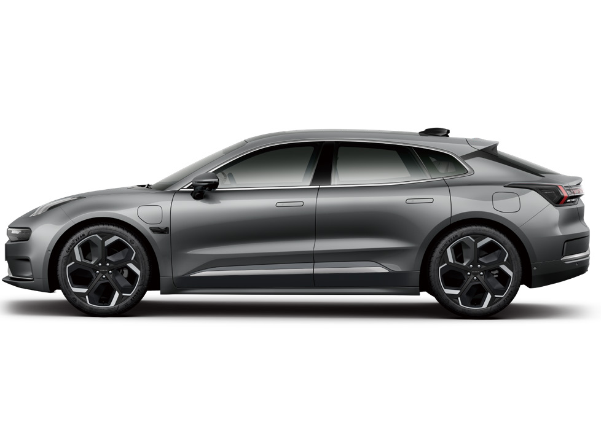
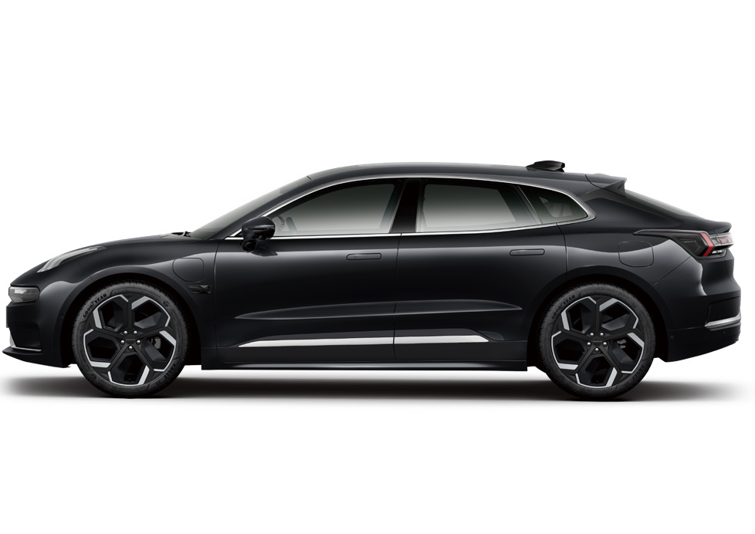
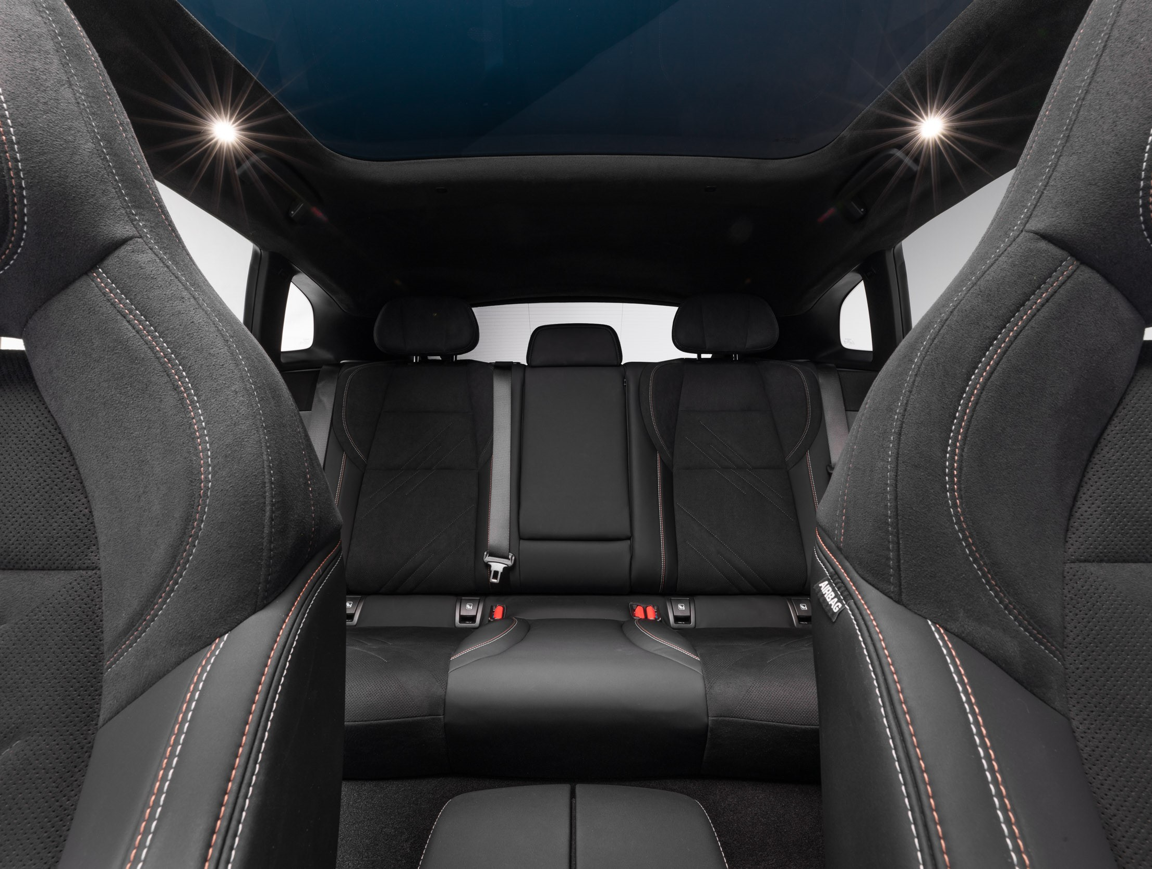
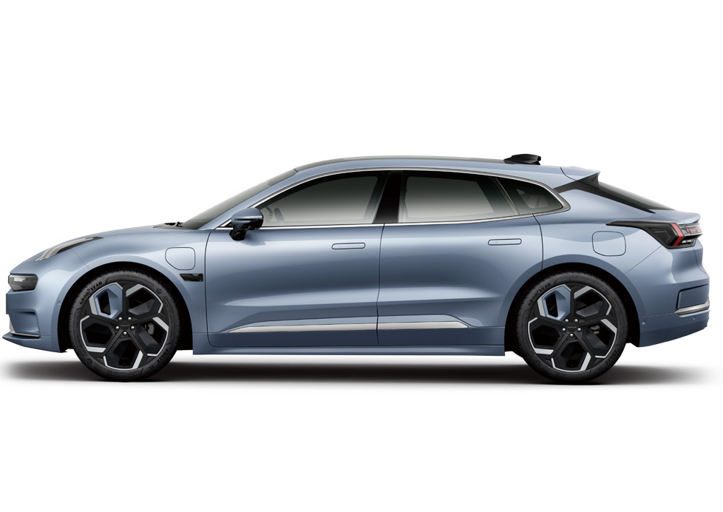
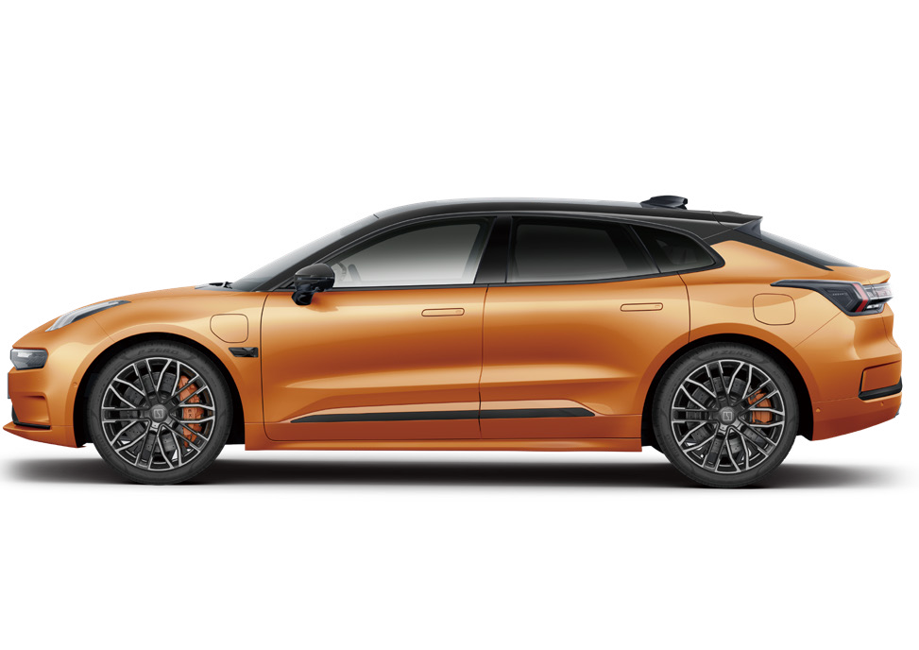


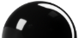

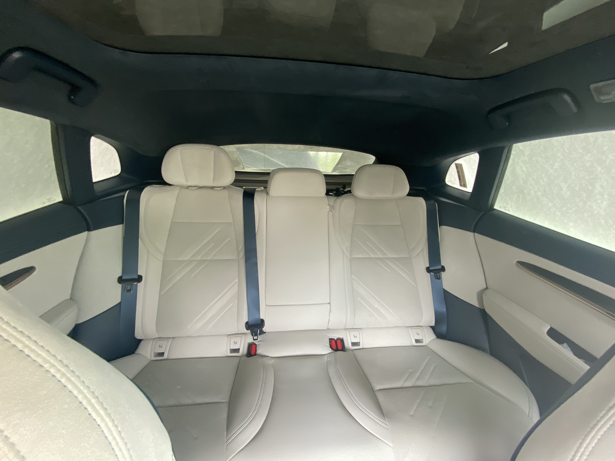



ZEEKR 001 Display
Exterior Car Paint
Cockpit Interior
White
Grey
Black
Blue
Orange
Orange Car Paint: Only for Flagship
Body Color Decoration: Standard for Standard and Premium
Contrasted Dark Decoration: Optional for Standard and Premium, Standard for Flagship
Charcoal Black & Stone Grey: Standard for all Trim Levels
Exterior Wheel Hub
21 inch
for Standard
22 inch
Standard for Premium
22 inch Forged Wheel
Optional for Premium, Standard for Flagship
Midnight Blue & Polar White: Optional for Standard and Premium, Standard for Flagship

